Slide 1
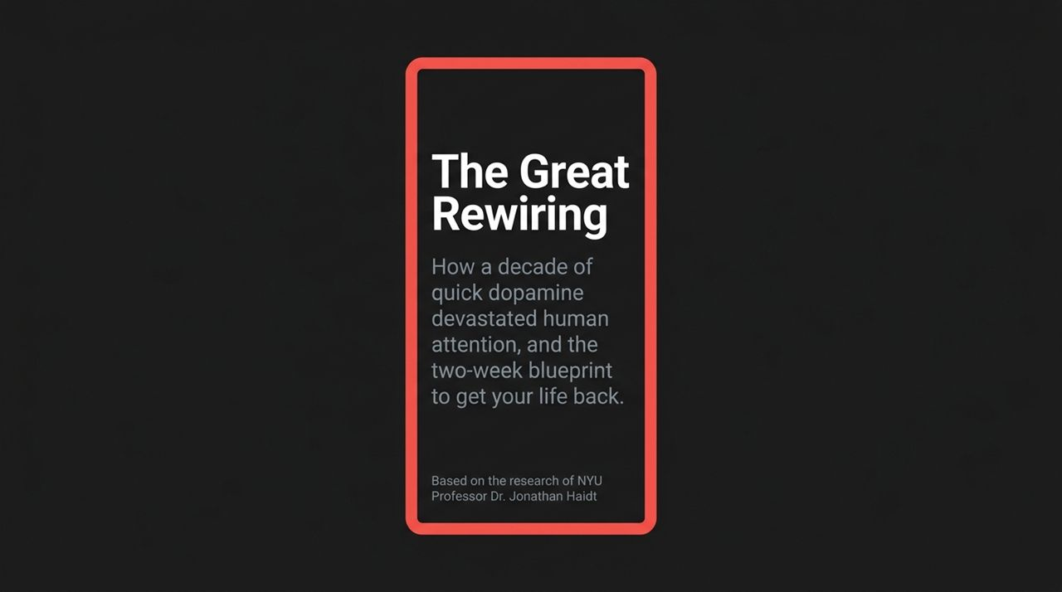
Notes:
Good morning/afternoon, everyone. Today, we are tackling one of the defining crises of the 21st century: the destruction of human attention and focus. Over the past decade, we have unwittingly participated in a massive neurological experiment.
Based on the landmark research of NYU Professor Dr. Jonathan Haidt—author of The Anxious Generation—we will examine how the shift to quick dopamine and continuous digital connection rewired human childhood and adult minds alike.
More importantly, this is not just a diagnosis of a problem. We will cover a simple, evidence-based two-week blueprint to reset your dopamine circuits, reclaim your cognitive capacity, and get your life back.
https://www.youtube.com/watch?v=DFcndrm7ql4

Slide 2
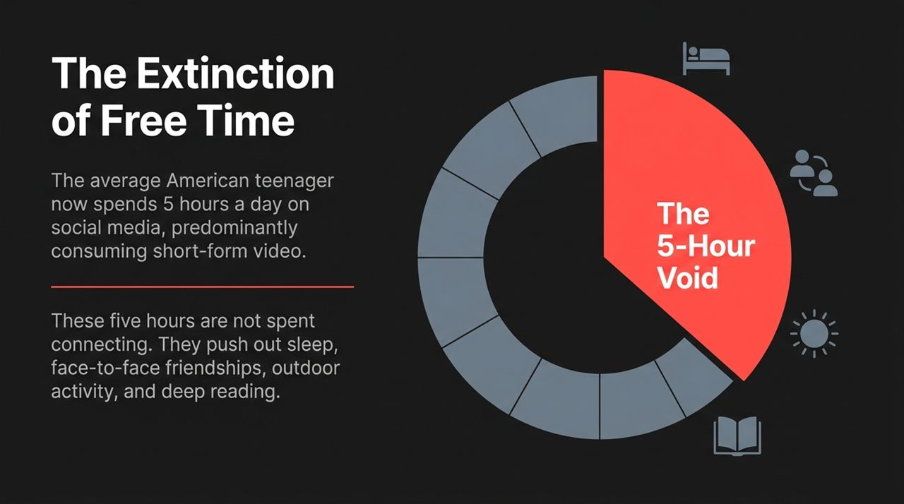
Notes:
Let’s start with a staggering statistic: The average American teenager now spends 5 hours every single day on social media, predominantly consuming short-form video content.
Think about what 5 hours a day actually represents. In a 16-hour waking day, almost a third of a person's life is swallowed by a screen.
Crucially, as Dr. Haidt points out, these five hours are not spent socializing or building deep connections. This is consumption, not community.
These 5 hours create what we call 'The 5-Hour Void'—pushing out the bedrock foundations of healthy human development: sleep, face-to-face friendships, outdoor activity, and deep reading.

Slide 3
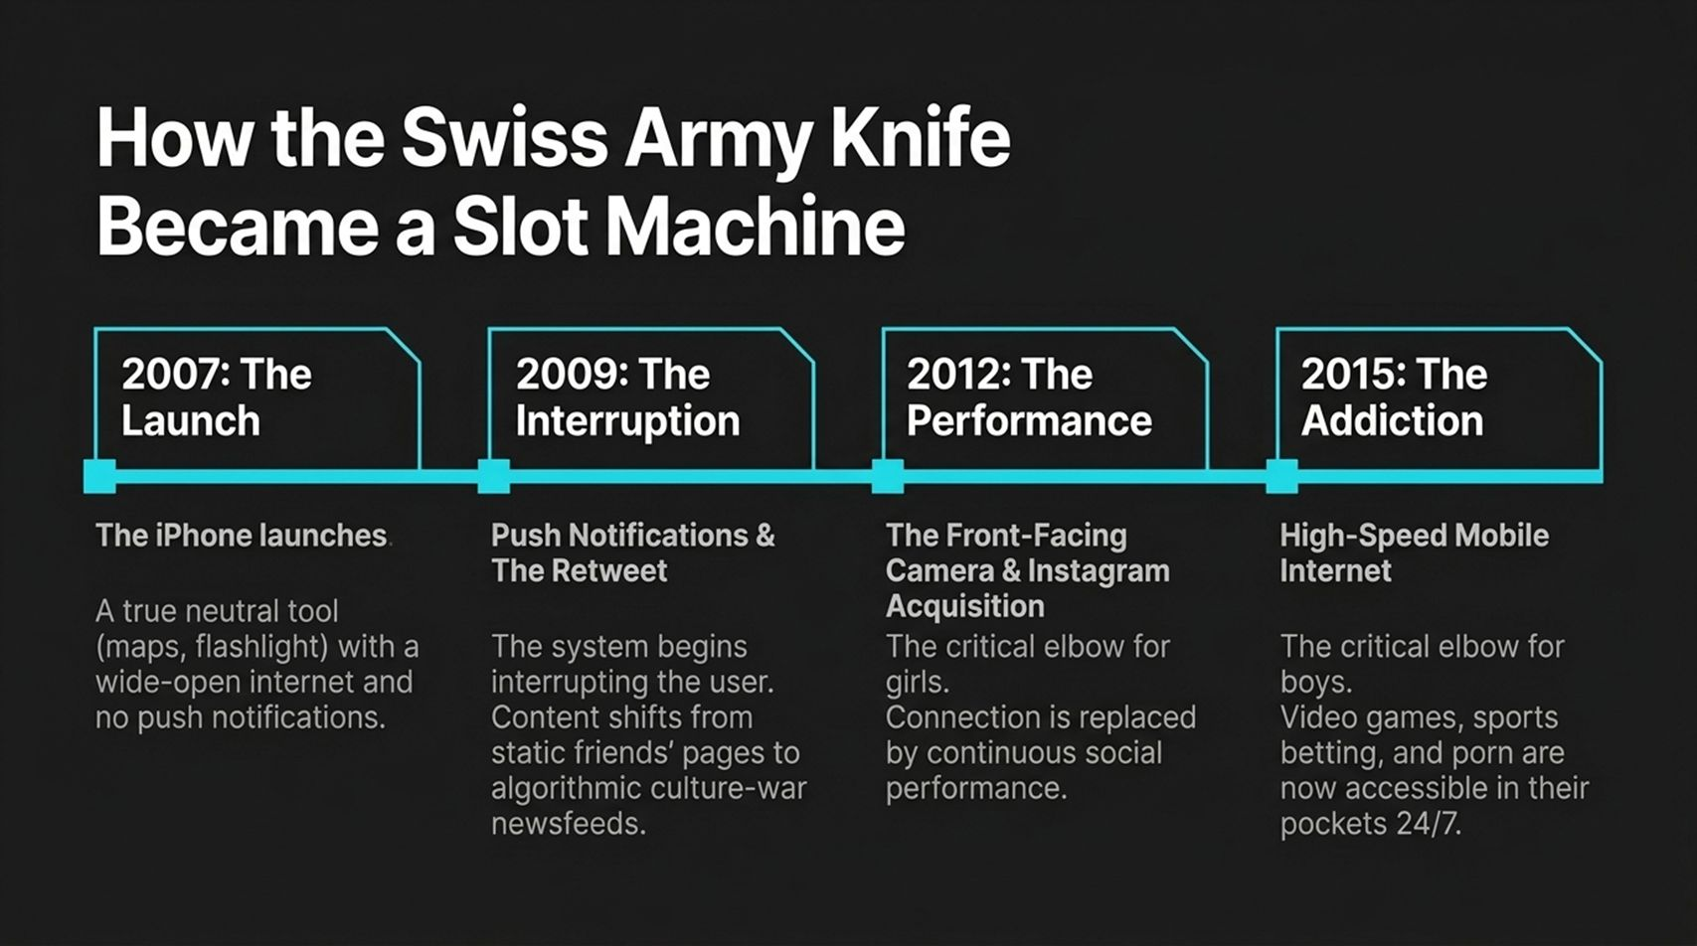
Notes:
How did we get here? It didn't happen overnight; it was an evolutionary shift between 2007 and 2015.
2007 (The Tool): When the iPhone launched, it was a neutral tool—like a digital Swiss Army knife with maps, a flashlight, and basic web access, but no push notifications or app ecosystem.
2009 (The Interruption): The invention of push notifications, newsfeeds, and the retweet button transformed static pages into real-time, algorithmic culture wars designed to interrupt you.
2012 (The Performance - Critical for Girls): Front-facing cameras arrived alongside Instagram's expansion. Connection was instantly replaced by continuous social performance.
2015 (The Addiction - Critical for Boys): High-speed mobile internet turned smartphones into 24/7 portals for video games, sports betting, and adult content—creating an instant dopamine engine.

Slide 4
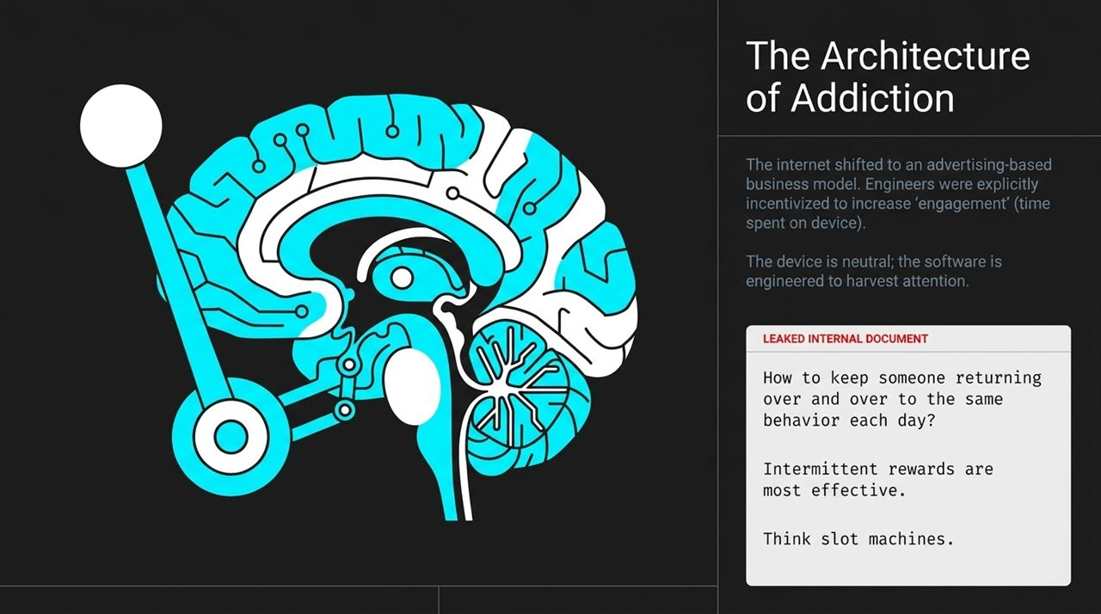
Notes:
We need to dispel a major myth: tech addiction is not a failure of individual willpower; it is an engineered outcome.
When platforms shifted to advertising-based business models, corporate incentives aligned around one metric: 'engagement' or time spent on device.
As revealed in legal discovery and whistle-blower documents, engineers—including internal neuroscientists—explicitly analyzed how to make apps addictive.
Internal memos directly asked: 'How to keep someone returning over and over to the same behavior each day? Intermittent rewards are most effective. Think slot machines.'

Slide 5
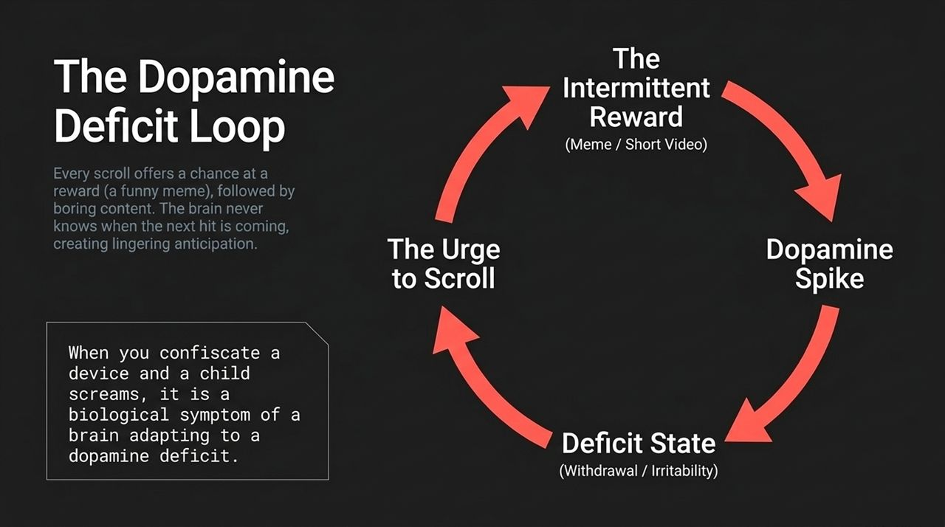
Notes:
Here is the neurological mechanics of why you can't put your phone down.
When you scroll, you experience variable intermittent rewards: boring post, boring post, hilarious meme (dopamine spike), boring post.
Because your brain cannot predict when the next hit is coming, it stays in a state of lingering anticipation.
When you confiscate a phone and a child throws a tantrum or screams, that is not simply bad behavior; it is a biological symptom of a brain adapting to a sudden dopamine deficit state.

Slide 6
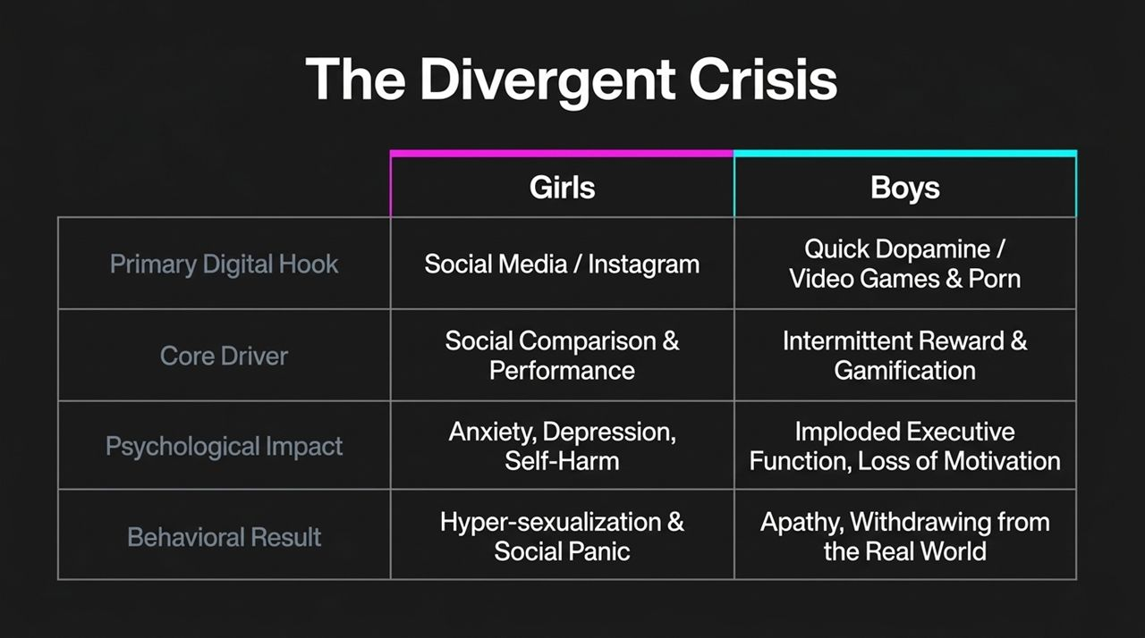
Notes:
The digital crisis impacts genders differently based on their primary digital hooks.
For Girls: The primary hook is social media (Instagram/TikTok). The core driver is social comparison and performance. This manifests as internalized harm—anxiety, depression, and eating disorders.
For Boys: The primary hook is quick dopamine through gaming, gambling, and adult content. This destroys executive function—the ability to set goals, plan, and execute. The result is externalized withdrawal, apathy, and failure to launch.

Slide 7
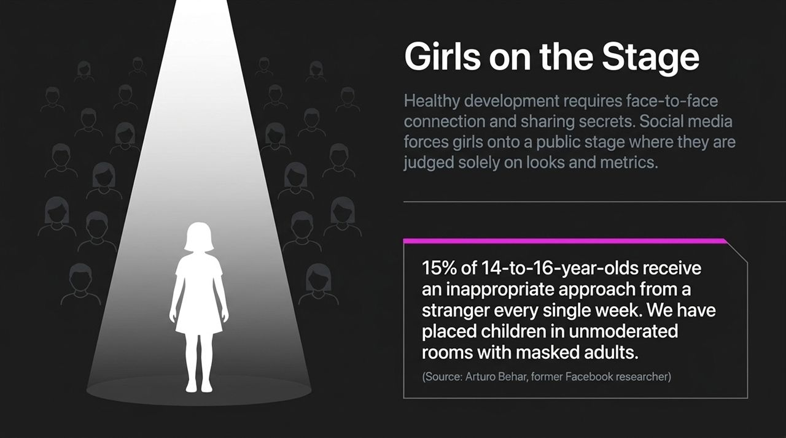
Notes:
Healthy adolescent development for girls requires face-to-face connection and private trust-building with close peers.
Social media thrusts young girls onto a public stage where they are continuously judged on looks, metrics, and peer evaluation.
Even worse, as former Facebook researcher Arturo Behar discovered, 15% of 14-to-16-year-olds receive an inappropriate sexual approach from a stranger every single week.
We have effectively placed our children in unmoderated virtual rooms with masked adults.

Slide 8
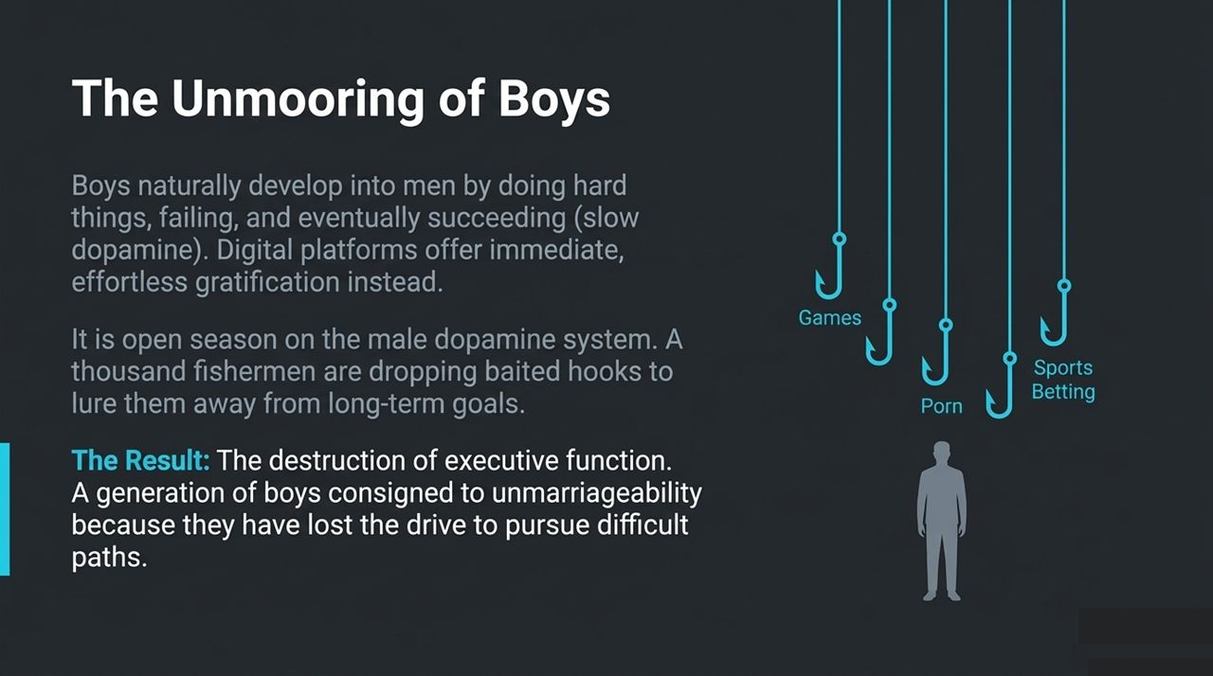
Notes:
Boys naturally transition into manhood through 'slow dopamine'—doing difficult tasks, failing, persevering, and achieving real mastery.
Today, there is an open season on the male dopamine system. Commercial entities are dropping thousands of baited hooks—video games, porn, and legalized sports betting—directly into their pockets.
The result is the erosion of executive function. A generation of young men is struggling with motivation, dropping out of the workforce, and losing the capacity to pursue real-world achievements.

Slide 9
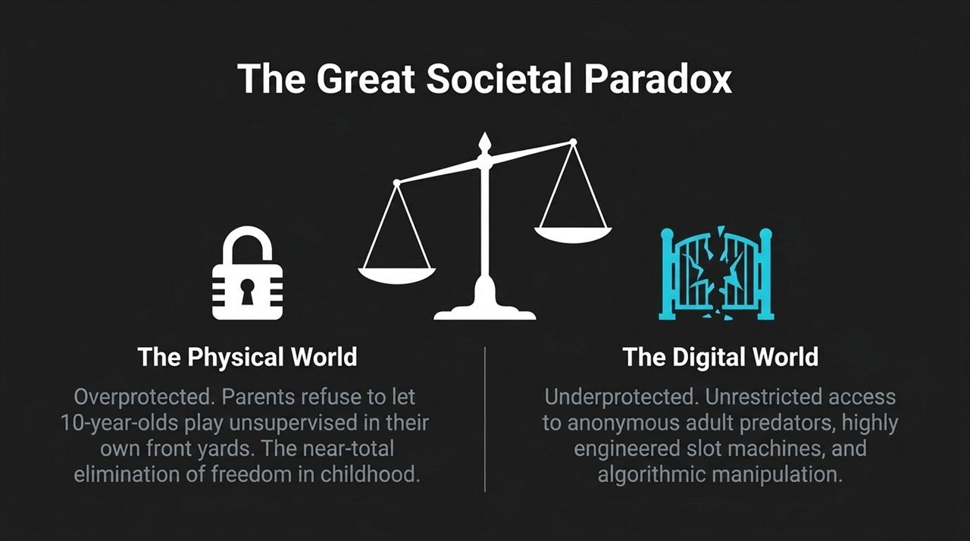
Notes:
Dr. Haidt summarizes our societal failure through a stark paradox:
In the Physical World: We have radically overprotected our children. Surveys show parents refuse to let 10-year-olds play unsupervised in their own front yards or visit parks alone.
In the Digital World: We underprotect them entirely. We hand them unrestricted access to global algorithmic slot machines and unvetted online environments.

Slide 10
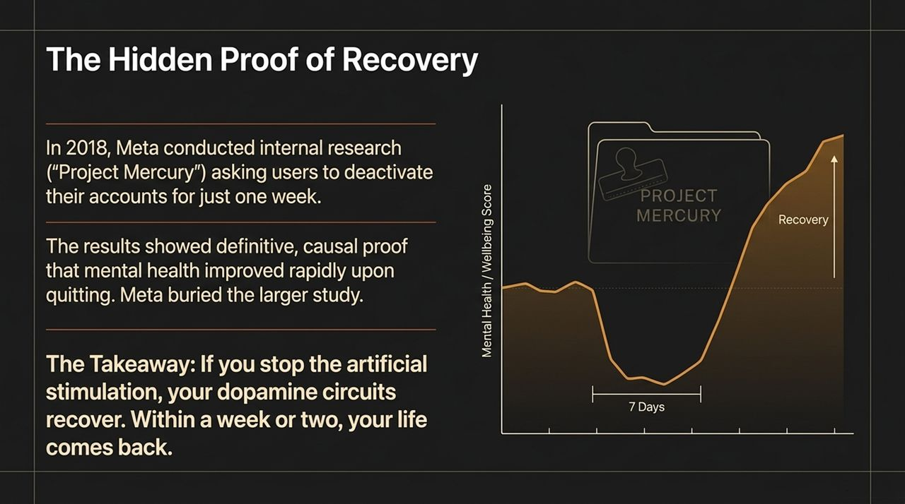
Notes:
Here is the critical, hopeful truth: Recovery is fast and proven.
In 2018, Meta conducted a internal study called 'Project Mercury,' where users deactivated accounts for just one week.
The internal data proved causally that stopping artificial digital stimulation led to rapid improvements in mental health and well-being within 7 to 14 days.
When you remove constant high-dopamine triggers, the human brain’s baseline dopamine sensitivity normalizes rapidly.

Slide 11
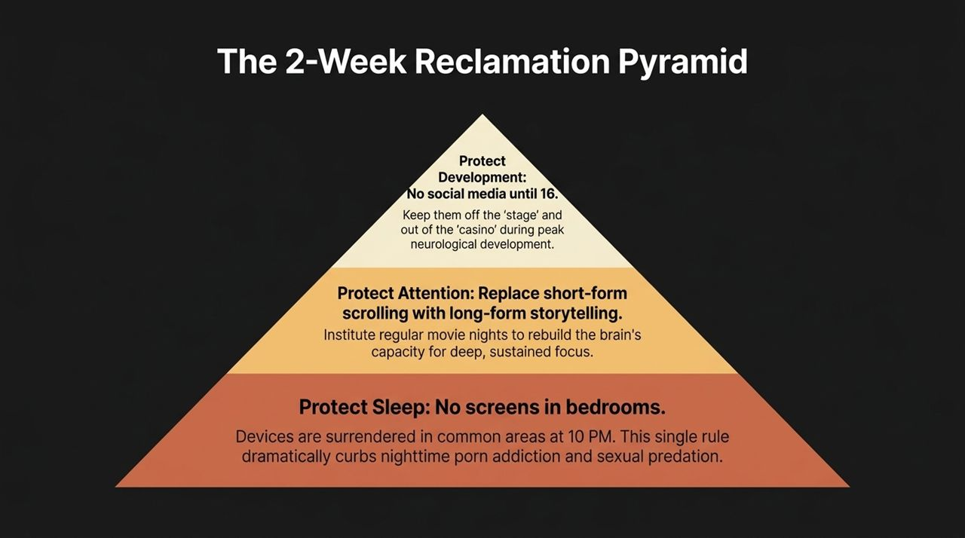
Notes:
To restore balance, we implement the 3-Tier Reclamation Framework:
Tier 1 (Base - Protect Sleep): No screens in bedrooms after 10 PM. Sleep deprivation magnifies anxiety, depression, and focus loss.
Tier 2 (Middle - Protect Attention): Replace short-form scrolling with long-form storytelling. Schedule movie nights or deep reading to rebuild sustained attention span.
Tier 3 (Top - Protect Development): No social media until age 16. Protect neurological development during vulnerable pubertal years.

Slide 12
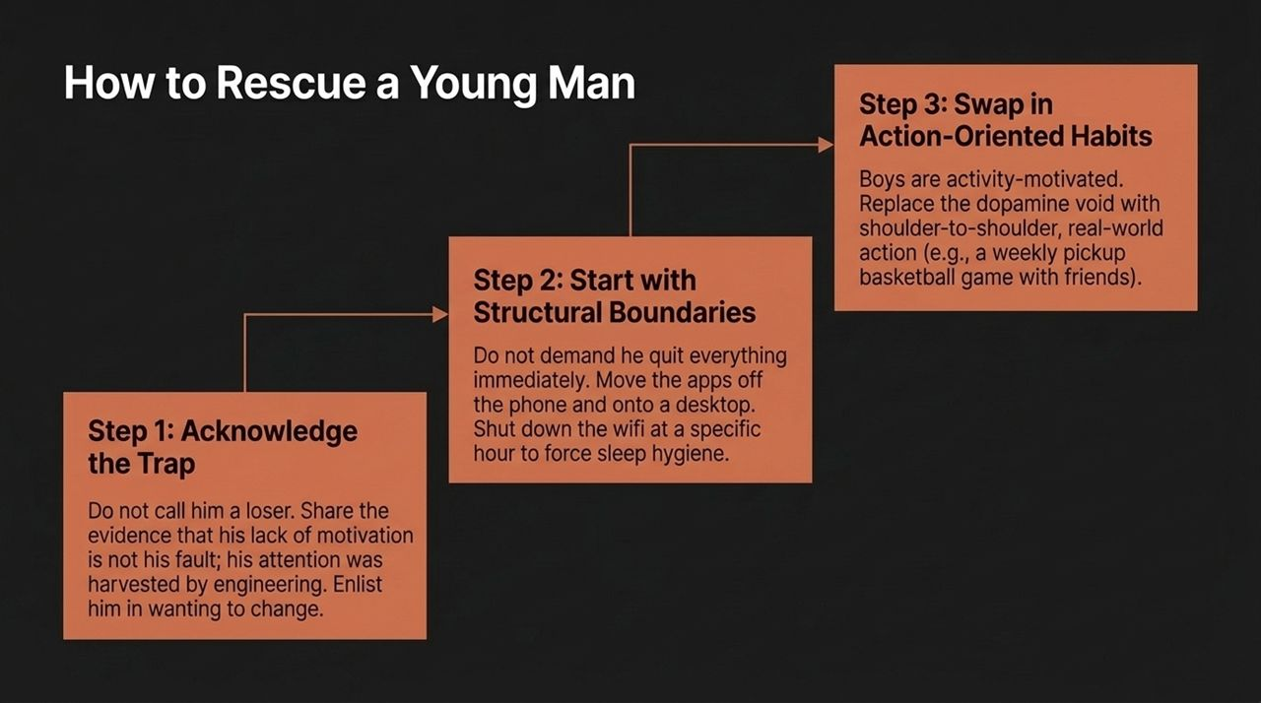
Notes:
If you are trying to help a young man who has lost drive and focus, follow this three-step protocol: Step 1: Acknowledge the Trap. Don't call him lazy. Explain that tech engineers specifically targeted his brain architecture. Enlist him as an ally in regaining his autonomy. Step 2: Structural Boundaries. Move apps off mobile devices onto desktop computers. Enforce night-time Wi-Fi shutoffs. Step 3: Action-Oriented Habits. Boys are activity-motivated. Replace the dopamine void with real-world physical activities—sports leagues, building projects, or outdoors.

Slide 13
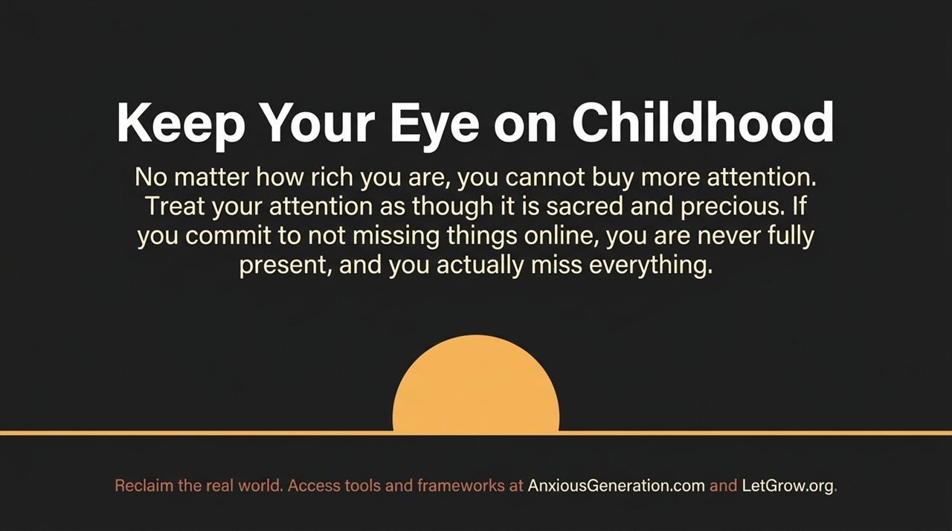
Notes:
As Dr. Haidt reminds us: 'No matter how rich you are, you cannot buy more attention.'
Treat your attention as something sacred. When you try not to miss anything online, you end up missing real life entirely.
We must focus on providing real-world autonomy, real-world play, and genuine human connection. Visit AnxiousGeneration.com and LetGrow.org for practical toolkits.

Slide 14
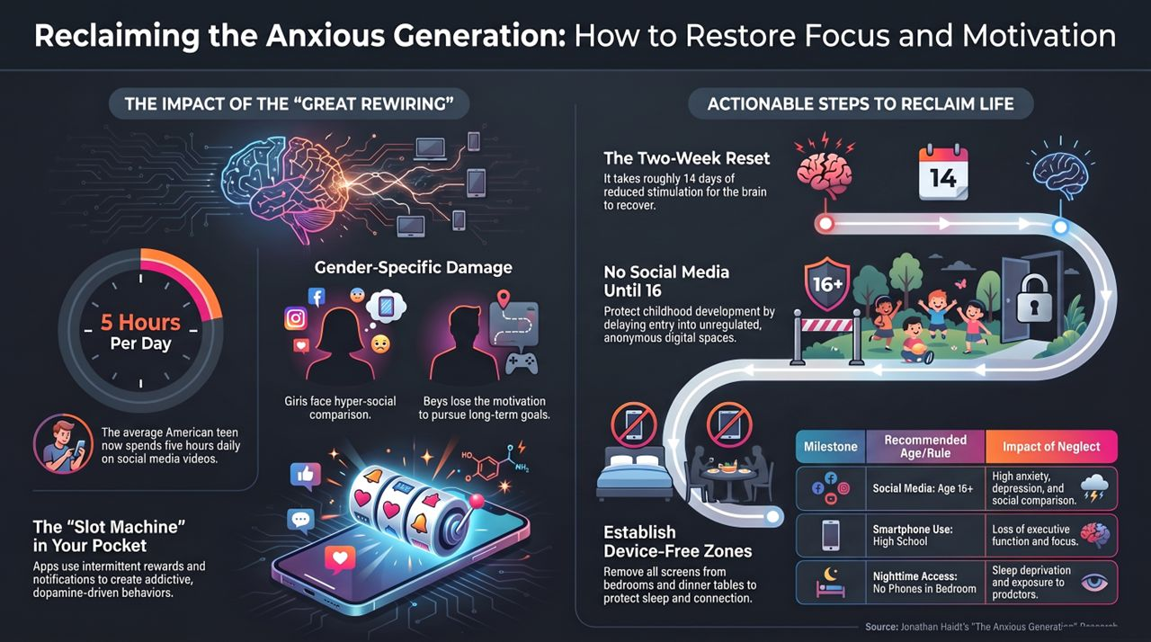
Notes:
To wrap up our discussion, let's review our complete action roadmap:
The Core Reality: The 5-hour daily void and slot-machine software design have compromised human attention and executive function.
The Action Plan:
Institute a strict 2-Week Reset to recalibrate baseline dopamine.
Enforce No Social Media until 16.
Create Device-Free Zones in bedrooms and dining areas.
By taking back control of our attention, we take back control of our lives.
https://www.youtube.com/watch?v=DFcndrm7ql4

